Slide 1
OpenWrt-Testlab
Eine Kombination von Geräten und eine Test-Bibliotek um Tests auf OpenWrt bassierte Routers zu testen
https://github.com/pmelange/openwrt-testlab

Slide 2
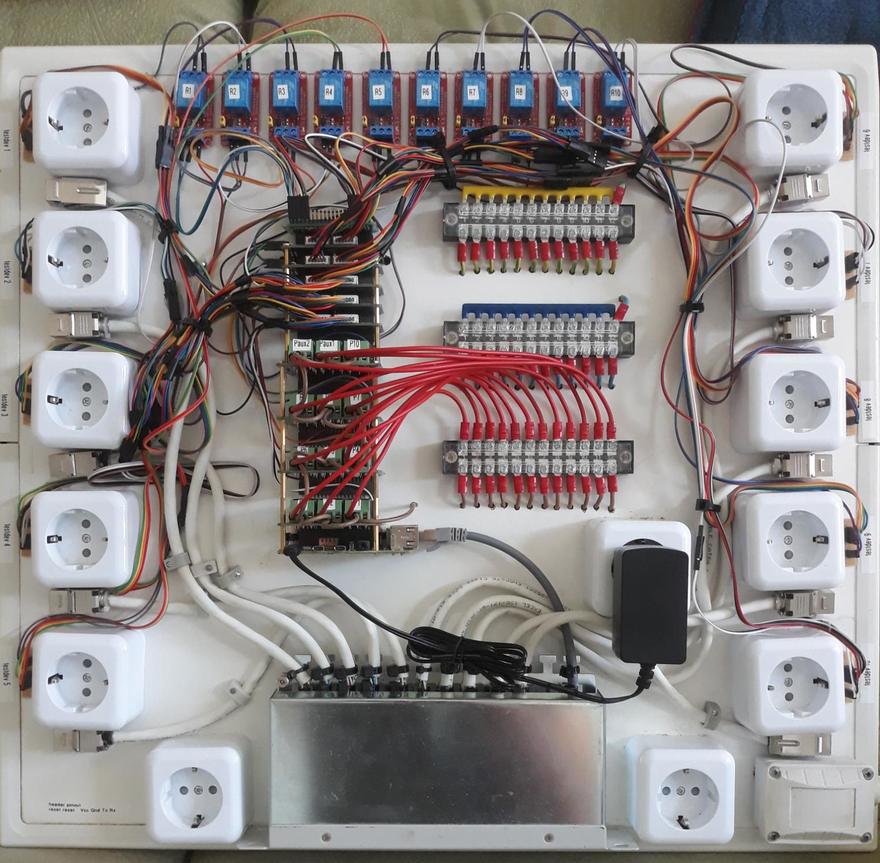
Hardware
Raspberry Pi 4B
4x Relay HATs (jeweils mit 3 Relais)
5x SerialExpansion HATs (Jede
mit 2 UARTs und 10 GPIOs)
10x Relais
12x Stromanschlüsse
10x RJ45 Buchsen

Slide 3
Routern
Jeder angeschlossene Router an der Testlab braucht kleine Anpassungen. Das Serielle-Interface muss erreichbar sein (Löten von Pins und Jumper-Kabeln ziehen) und der Reset-Taste muss auch mit Jumber-Kabeln an der Reset-Taste angeschlossen werden
Möglische anpassungund beit U-Boot Einstellungen

Slide 4
Automatisation und Tests
Labgrid exportiert Resoursen von der Testlab damit nutzern während Tests asufüren resiveren mussen for users to acquire when running a test (network port, serial interface, power, reset button)
Labgrid and pytest are used to automate flashing, filling out the wizard, and running tests
Possibility to add CI integration (github/buildbot)

Slide 5
Types of Tests
Sanity Checks: Are daemons running? Is there still flash space available?
Proof of Concept: Is there a new feature? Test it here first.
Simulations: Build a test mesh-network and throttle it until it breaks (or not).

Slide 6
Labrid
https://github.com/pmelange/labgrid is a fork of the project where I make modifications to their code. Some of the Pull Requests have been integrated upstream. Other PR’s are waiting.
In the openwrt-testlab repo there is an additional labgrid/ directory where testlab specific modules are located.

Slide 7
Labgrid (2)
Consists of the labgrid-coordinator, labgrid-exporter, and labgrid-client.
The labgrid-coordinator manages connections and resource reservations between exporter(s) and client(s).
The labgrid-exporter provides exported access to the hardware used to run the tests (power supply, serial port). There can be multiple exporters connected to one coordinator.

Slide 8
Labgrid (3)
The labgrid-client can be run from any computer which has ssh access to the exporter. Therefore it is possible to design new tests locally and run them on the testlab.
Any number of clients may connect to the exporter at the same time, but resources are only available after the client acquires them. There is a mechanism to wait for resources to become available again before acquiring them
Resources are grouped together into logical groups such as port1 and port2, each with it’s own network interface, serial port, etc.

Slide 9
pytest
https://docs.pytest.org
«The pytest framework makes it easy to write small, readable tests, and can scale to support complex functional testing for applications and libraries.»
Integrated directly into labgrid and therfore the python modules written in labgrid can be used within pytest.

Slide 10
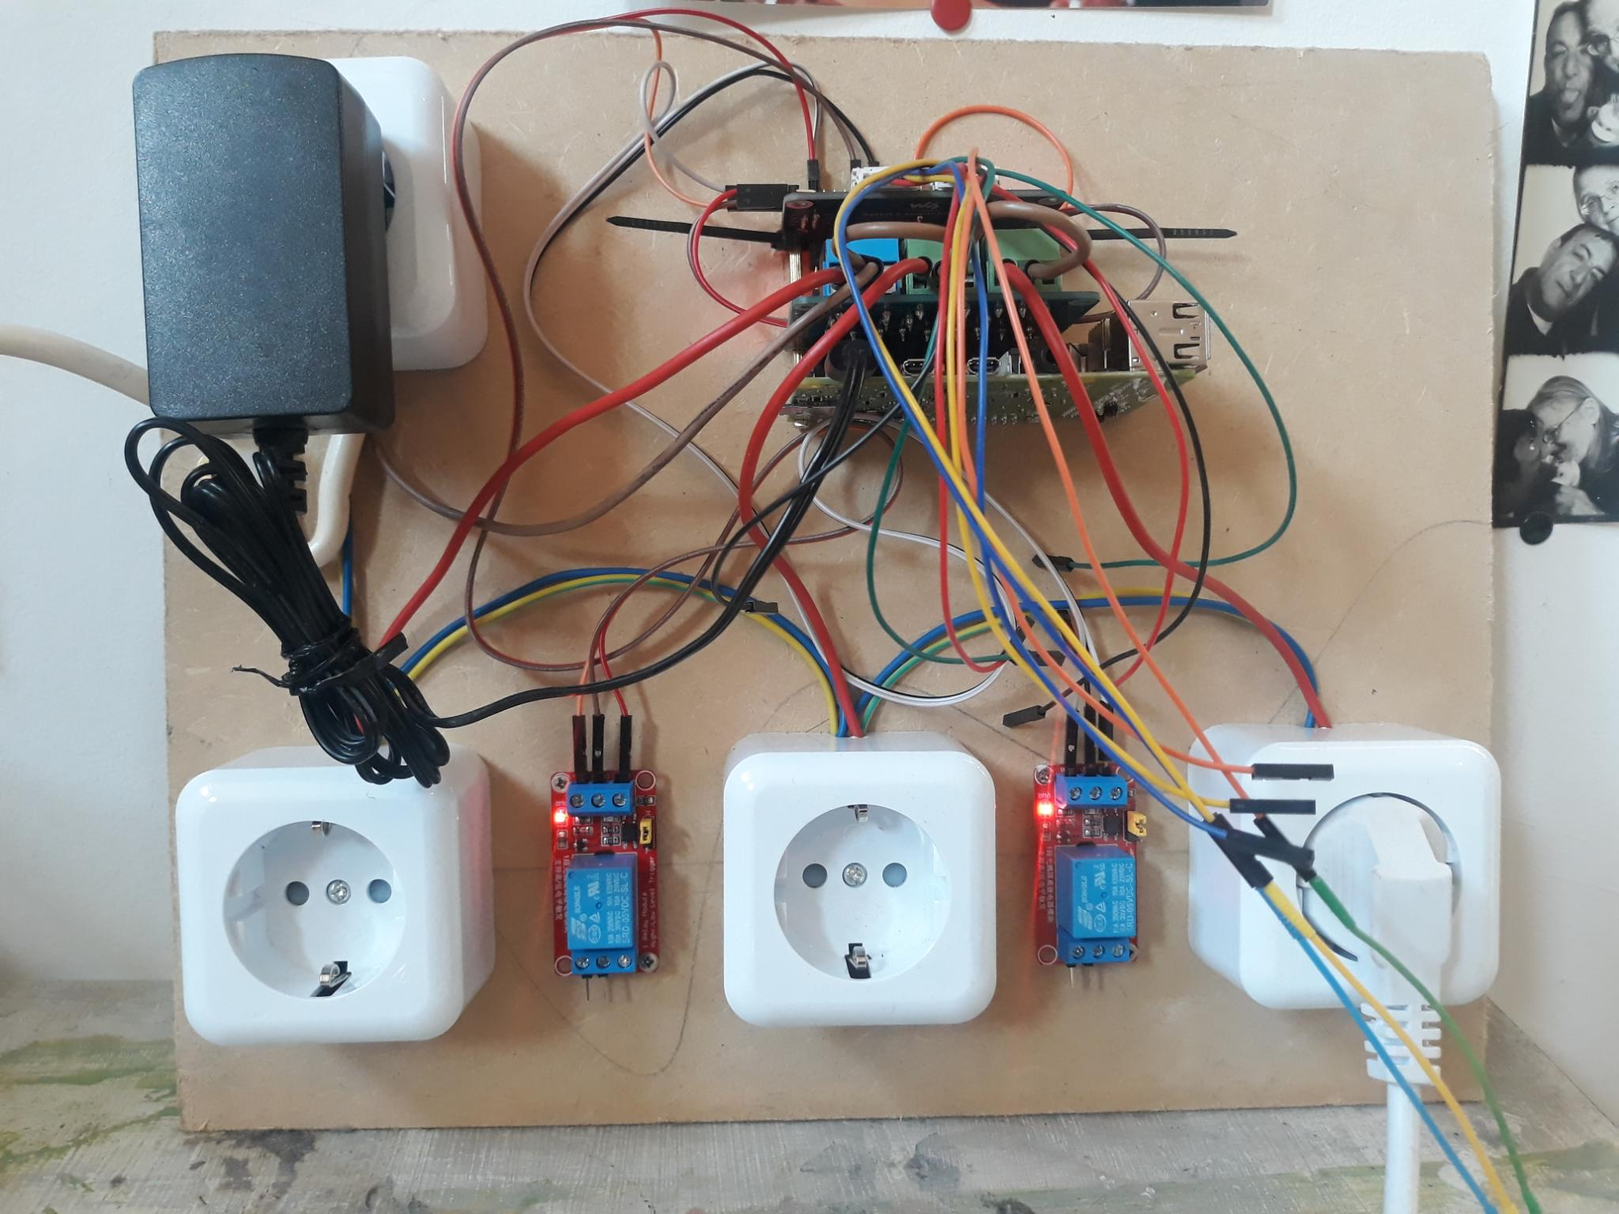
Demonstraton
If you have any questions, this is also a good time to ask.

